Slide 1

THE MIX, THE MASTER AND THE MODEL
Classifying song release dates using Spotify API
Sam Lupton

Slide 2

LINEUP
Contact: sam_lupton@hotmail.co.uk
Supporting act
What data can Spotify give us?
What is mastering? Why should we care?
Special guests
Approaches to sampling
Outliers and cleaning
Headliner
Modelling music eras based on features
Analysing the results
Afterparty
Conclusions
Caveats
Upcoming events
Apps & different samples
Notes:
Aim - classify songs by decade
Metrics - accuracy, but to some extent recall (we want to give every class a fair chance of being predicted)

Slide 3
1.
Supporting act
First principles

Slide 4
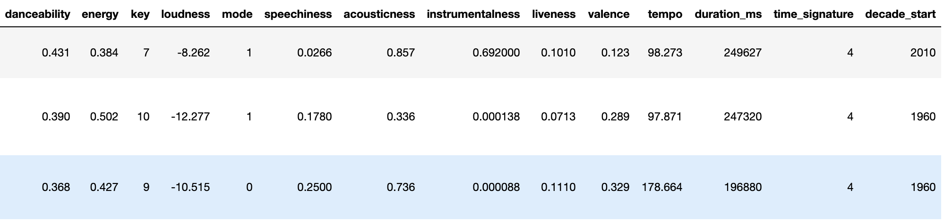
SPOTIFY API AND SPOTIPY
Spotipy — a Python library for the Spotify API
Identifying features and audio analysis
Limitations
Notes:
Artist, album and track all referenced through Spotify’s URI (Uniform Resource Identifier) system, which is a superset of the URL - a uniquely identifying string of characters.
Referencing the song uri lets you get extract the features.
Decade_start extracted from release_date feature.
Features
danceability(float) - Danceability describes how suitable a track is for dancing based on a combination of musical elements including tempo, rhythm stability, beat strength, and overall regularity. A value of 0.0 is least danceable and 1.0 is most danceable.
key(int) - The estimated overall key of the track. Integers map to pitches using standard Pitch Class notation . E.g. 0 = C, 1 = C#, 2 = D, and so on. If no key was detected, the value is -1.
energy(float) - Energy is a measure from 0.0 to 1.0 and represents a perceptual measure of intensity and activity. Typically, energetic tracks feel fast, loud, and noisy. For example, death metal has high energy, while a Bach prelude scores low on the scale. Perceptual features contributing to this attribute include dynamic range, perceived loudness, timbre, onset rate, and general entropy.
mode(int) - Mode indicates the modality (major or minor) of a track, the type of scale from which its melodic content is derived. Major is represented by 1 and minor is 0.
loudness(float) - The overall loudness of a track in decibels (dB). Loudness values are averaged across the entire track and are useful for comparing relative loudness of tracks. Loudness is the quality of a sound that is the primary psychological correlate of physical strength (amplitude). Values typical range between -60 and 0 db.
speechiness(float) - Speechiness detects the presence of spoken words in a track. The more exclusively speech-like the recording (e.g. talk show, audio book, poetry), the closer to 1.0 the attribute value. Values above 0.66 describe tracks that are probably made entirely of spoken words. Values between 0.33 and 0.66 describe tracks that may contain both music and speech, either in sections or layered, including such cases as rap music. Values below 0.33 most likely represent music and other non-speech-like tracks.
acousticness(float) - A confidence measure from 0.0 to 1.0 of whether the track is acoustic. 1.0 represents high confidence the track is acoustic.
instrumentalness(float) - Predicts whether a track contains no vocals. 'Ooh' and 'aah' sounds are treated as instrumental in this context. Rap or spoken word tracks are clearly vocal. The closer the instrumentalness value is to 1.0, the greater likelihood the track contains no vocal content. Values above 0.5 are intended to represent instrumental tracks, but confidence is higher as the value approaches 1.0.
liveness(float) - Detects the presence of an audience in the recording. Higher liveness values represent an increased probability that the track was performed live. A value above 0.8 provides strong likelihood that the track is live.
valence(float) - A measure from 0.0 to 1.0 describing the musical positiveness conveyed by a track. Tracks with high valence sound more positive (e.g. happy, cheerful, euphoric), while tracks with low valence sound more negative (e.g. sad, depressed, angry).
tempo(float) - The overall estimated tempo of a track in beats per minute (BPM). In musical terminology, tempo is the speed or pace of a given piece and derives directly from the average beat duration.
duration_ms(int) - The duration of the track in milliseconds.
time_signature(int) - An estimated overall time signature of a track. The time signature (meter) is a notational convention to specify how many beats are in each bar (or measure).
decade_start - The YYYY date of the beginning of the decade from which the album comes.
Limitations
No firm information about how Spotify uses signal processing to generate these features, nor a sense of how accurate they are, nor access to the audio files (obv) - restricted to a superficial level and inferring the exact meaning of the features.
Cassettes were around in the 50s, CDs in the 70s; quality from converting these to digital format will be determined by the original format, and Spotify will usually be taking audio that has already been processed to some extent. From the 80s, we’re working on the same goalposts.

Slide 5
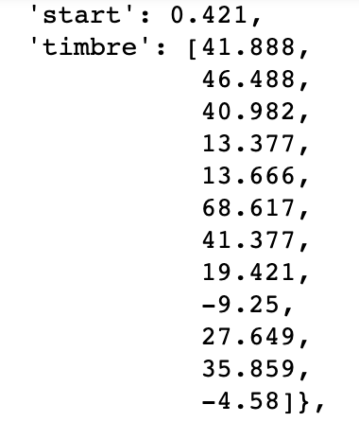
LOW-LEVEL FEATURES
Notes:
Spotify provides a hard to interpret, low-level analysis of all its songs analysing various features at half-second intervals
Timbre is an underdocumented feature with vague descriptions such as the ‘brightness’ of a sound
From raising an issue on Github, I found this is because the 12 coefficients of timbre come from PCA on the original signal of a track
Probably risks copyright issues to allow users to reconstruct this original signal
They most likely use this feature to get the higher-level features.
My own PCA from their features gave very different results, probably because PCA of analysis of PCA is a fairly random thing
Annoying, because I would have liked to look at things such as ‘bassiness’, which I reckon would increase over time

Slide 6

Librosa
A library allowing deeper analysis of audio files
Getting all the audio files to analyse = a few years’ prison
We can still look at a couple
Notes:
Luckily, I have Librosa to help. It’s a package which lets you analyse audio files at a low-level.
To apply it to all 30K rows of the dataset would mean some pretty risky torrenting
We can still look at a couple to see what kind of things we can model

Slide 7

I WANT TO PLAY A GAME
Spectrograms: representation of an audio file by amplitude at different frequencies over time
One of the following tracks is from the 1960s, one from the 2010s
Can you guess which is which?
Notes:
Let’s use spectrograms to contrast two songs.
Spectrograms: representation of an audio file by amplitude at different frequencies over time

Slide 8
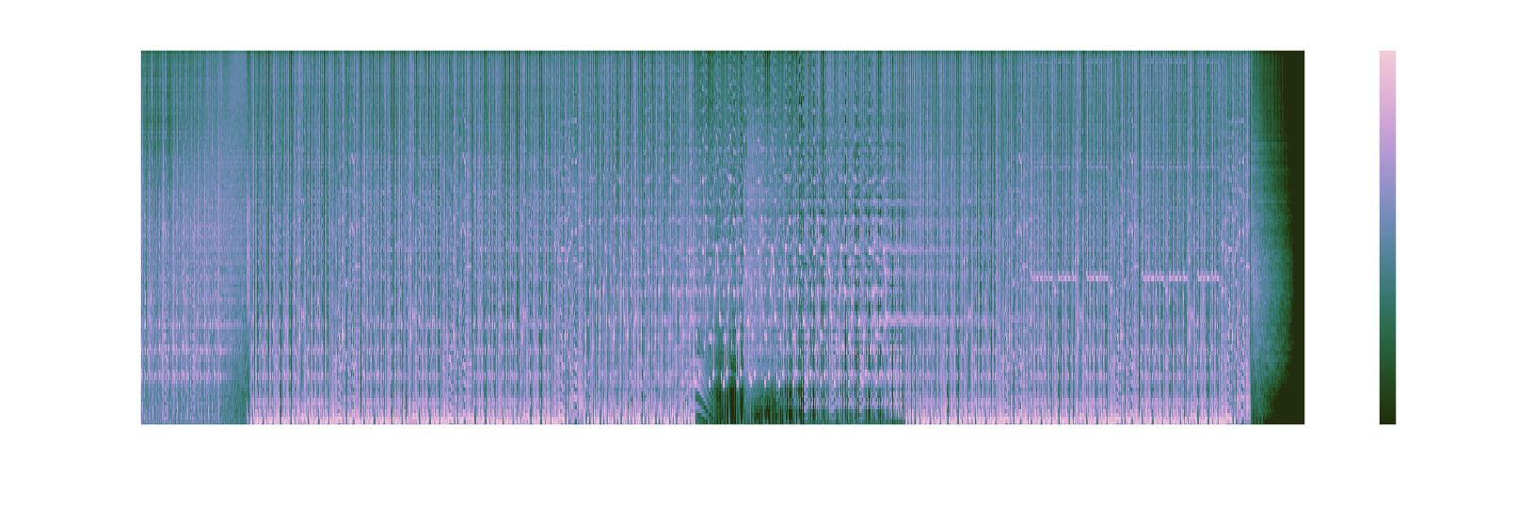
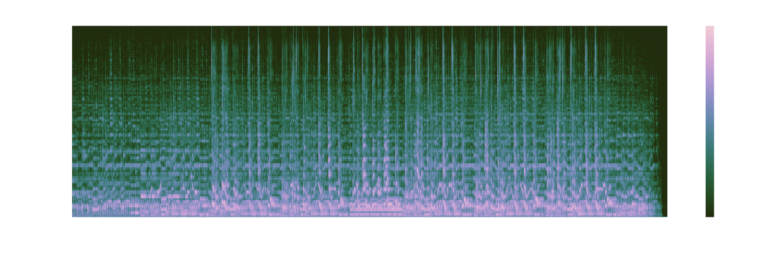
Notes:
N.B. Logarithmic scale, objective cap at 0dB like always

Slide 9

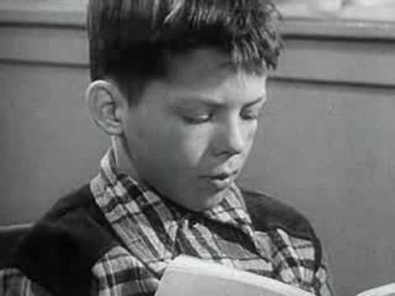
Spectrogram 1: Deadmau5 & Wolfgang Gartner - Animal Rights
2010
Electronic Dance Music
Modern production standards
Spectrogram 2: Jefferson Airplane -
Comin’ Back to Me
1967
Psychedelic Folk
Not much processing, very acoustic
Notes:
The first is Deadmau5 and Wolfgang Gartner's Animal Rights, an EDM/Progressive house hit from 2010.
The second is Jefferson Airplane's Comin' Back To Me, a psychedelic folk number from 1967.
With spectrograms, we can see the effect of 43 years' technological development in music. Namely, The signal is far stronger in the first graph, as well as far more consistent throughout the spectrum. This is because, in the era of studio recordings with very little post production, variation in auditory space could only come from deliberate instrumentation and arrangement.
This is the kind of thing we want to use in our model

Slide 10
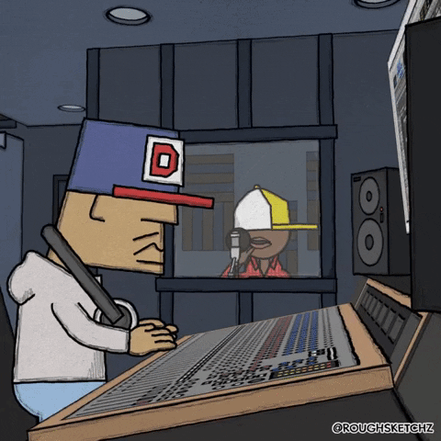
MASTERING
Compression
EQ
Demo time!
Notes:
Remember last time?
Compression squishes dynamic range, reducing loud, amplifying small sounds.
Anything above a threshold gets cut by a ratio you define.
You can then bring all the levels up to near the maximum output for any given playback device.
Let’s see what limiters (extreme compressors operating on louder sounds) do (click)

Slide 11

BUT WHY CAN’T WE JUST TURN IT UP?
Witness:
Clipping
Notes:
Remember last time?
Compression squishes dynamic range, reducing loud, amplifying small sounds.
Anything above a threshold gets cut by a ratio you define.
You can then bring all the levels up to near the maximum output for any given playback device.
Let’s see what limiters (extreme compressors operating on louder sounds) do (click)

Slide 12
Only dead people need loud music, you know.
- Alice Walker, author of ‘The Color Purple’

Slide 13
REALLY?
Exposure
Environment
Egregiousness
Louder music → Standing out →
More plays → $$$
To be played in a club, you need well balanced music at the right level
One album track being significantly louder/quieter than the rest → Poor listening experience
1
2
3
Notes:
All of these things and technology explain why the spectrograms earlier were different

Slide 14
EVERYONE WANTS THEIR MUSIC TO BE LOUD
But some are limited by technology

Slide 15
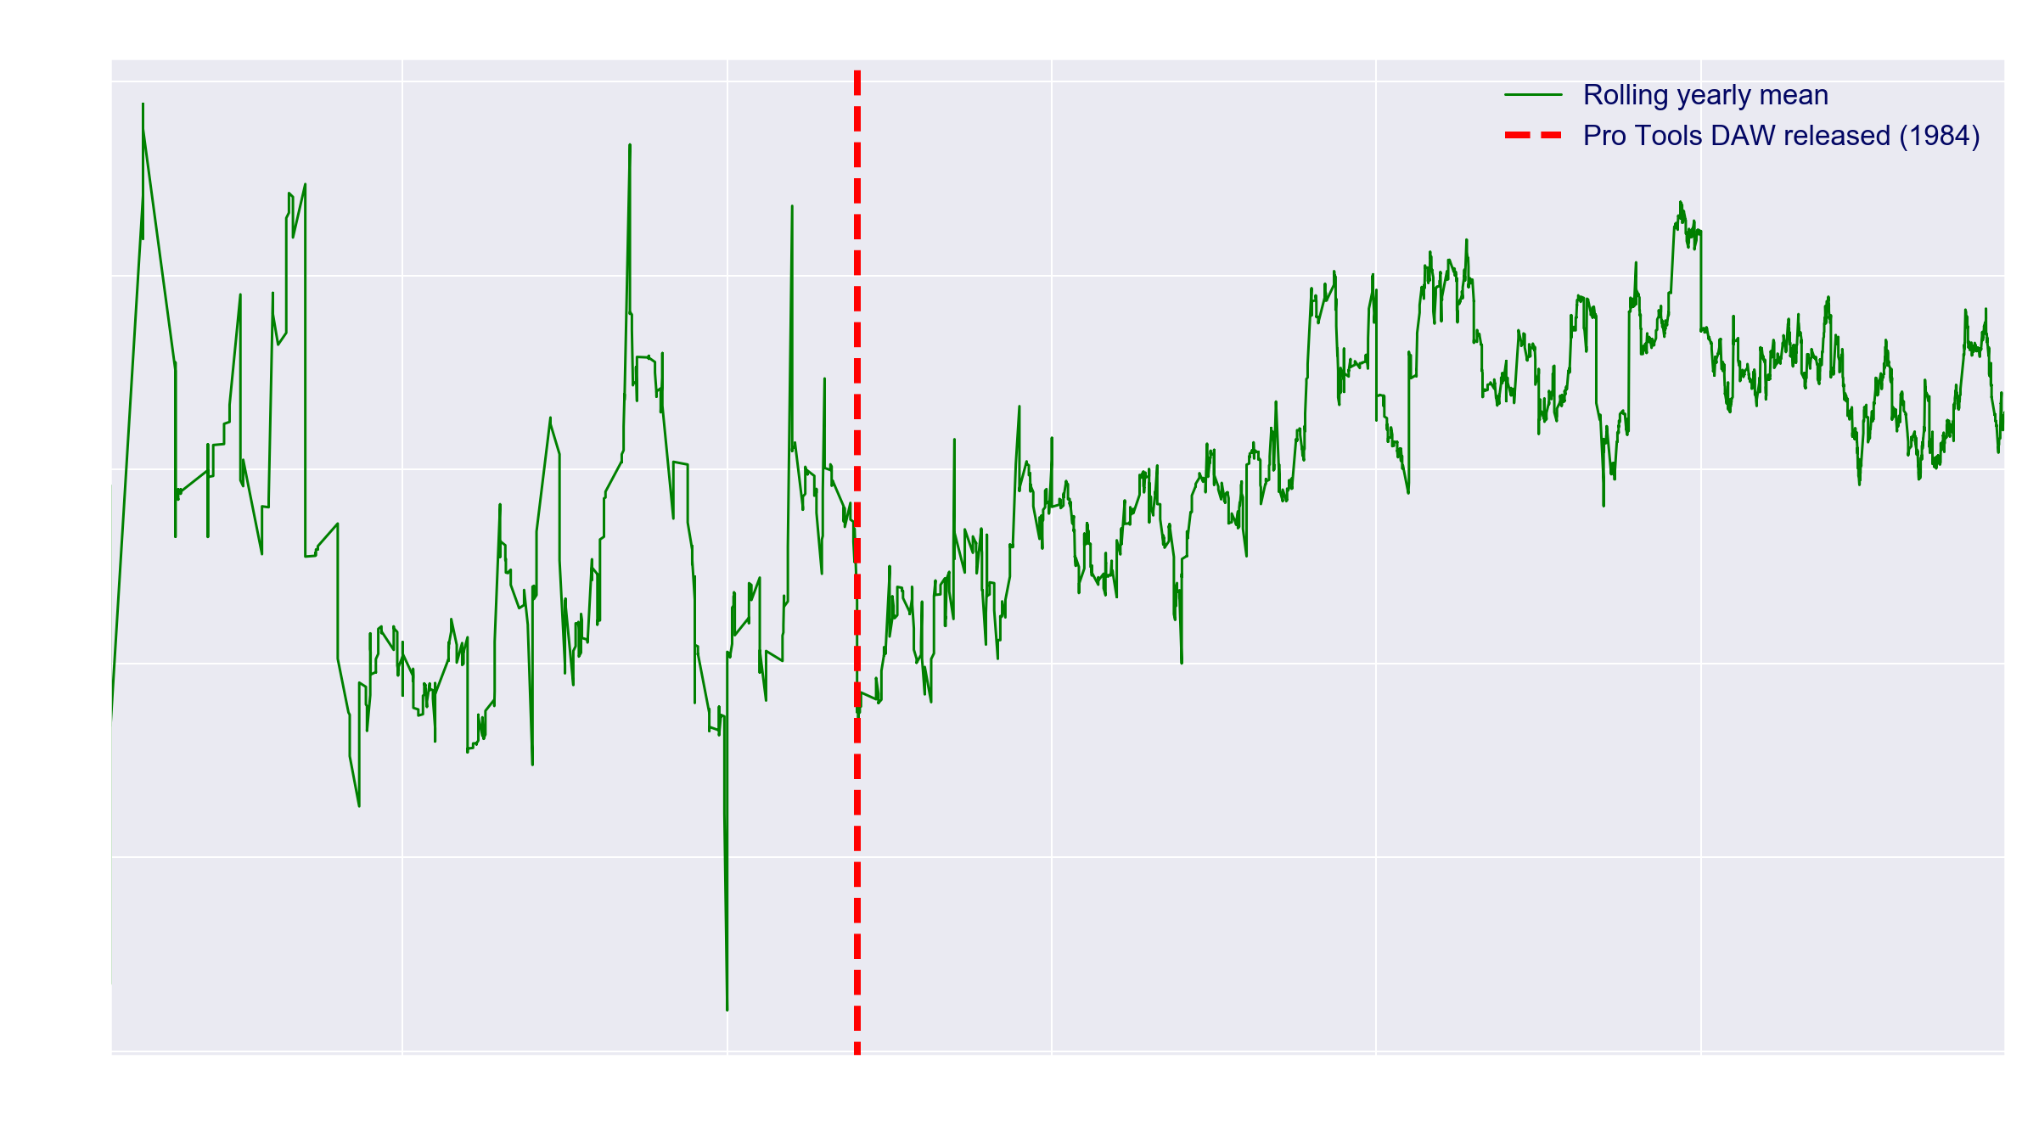
LOUDNESS, VISUALISED
Notes:
'Loudness' in music has been a hotly-debated topic over the last few decades. Even as early as the 1940s, when jukeboxes were popularised, musicians began to notice that they could make their tracks stand out more by having them produced to maximum volume, because the jubebox would be set at a predetermined volume allowing for variation between songs. The ensuing loudness war would come to define music mastering over the decades, as producers used whatever technology was available at the time to compress and then boost a track to as loud as it could be played.
When, in the 80s, affordable production software was released, any amateur could now boost a track to a much louder volume than previously possible. We can see this reflected in the data: the rolling yearly mean of loudness is very variant pre-1980
Clearly the loudest thing there is the noise (!)
, but after the 1984 release of Pro Tools Digital Audio Workstation, one of the earliest popular DAWs, there is a steady increase in loudness as it becomes easier and easier to max out a track's volume.
There’s still a debate on whether this overbearing production compromises the nuance in music; either way it’s a great help for our modelling purposes.
N.B. Spotify isn’t reliably dating most things before the 1980s, when tracks were converted to digital from various other sources with post-production rather than produced digitally.

Slide 16
WHAT’S TO BE GAINED
Musicology — how has music actually changed
What are the defining features of the eras
Does modern music actually all sound the same?
What can we tell an aspiring mastering engineer?
How well do Spotify’s features actually describe music?
Notes:
If we can effectively model using features like loudness, we can describe in objective terms how music has changed over the years, understand more about the sound of each era, respond to claims that modern music all sounds the same, and give some tips to aspiring mastering engineers.

Slide 17
2.
Special guest
Sampling & cleaning

Slide 18
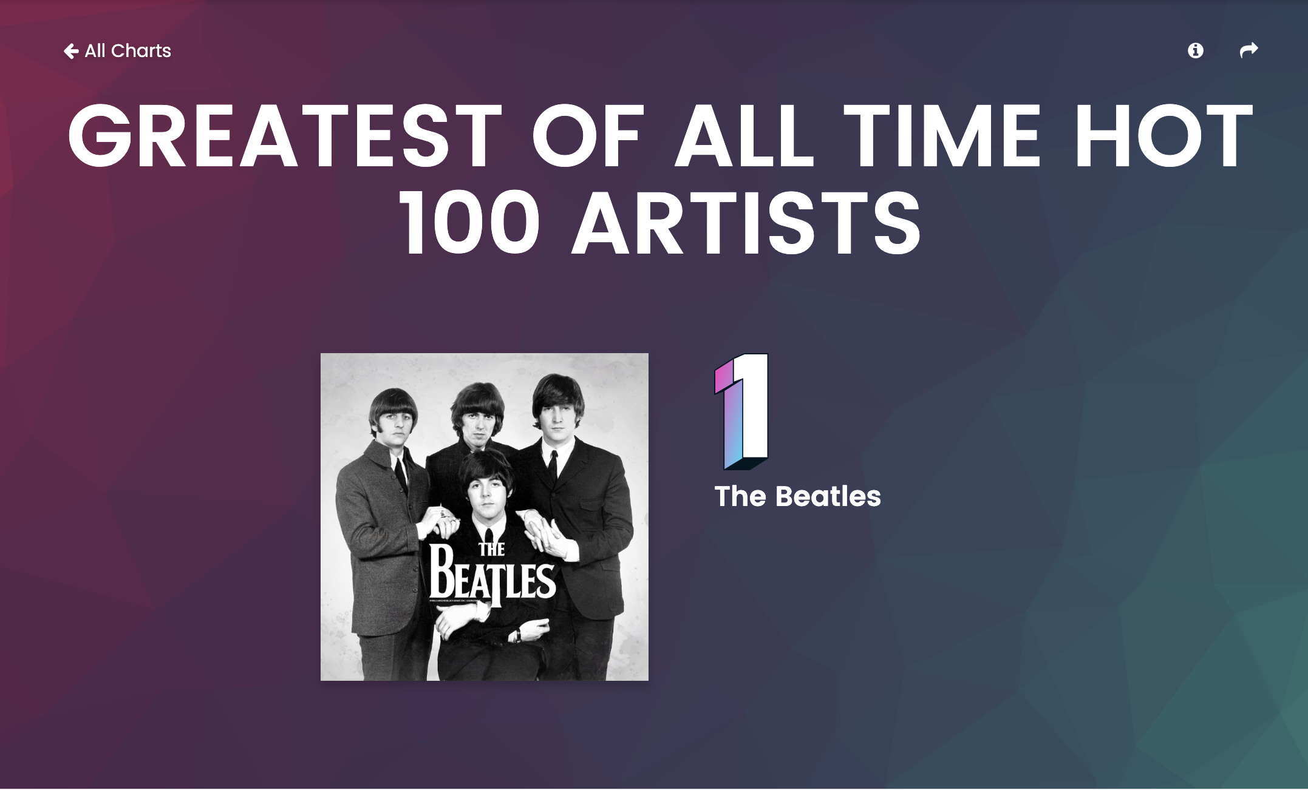
BILLBOARD TOP 100
Based off weeks spent in the chart top 10
Good spread of artists from last 60 years (launched 1958)
Notes:
Skewed, if anything, in favour of older artists, who have had longer to be in the charts, and arguably less competition
Scraped the names off the website
Made a module to iterate through all the artists, get their URIs, then get the albums, check if the album was a duplicate (there are many Spotify duplicate albums with different URIs), if not loop through all the songs and append them to a list of lists
Made another one to put all the info in a dataframe and extract the decade_start
Problem - even if an artist was mainly active in the 60s, by the nature of digital re-release, most of the albums listed were much later

Slide 19
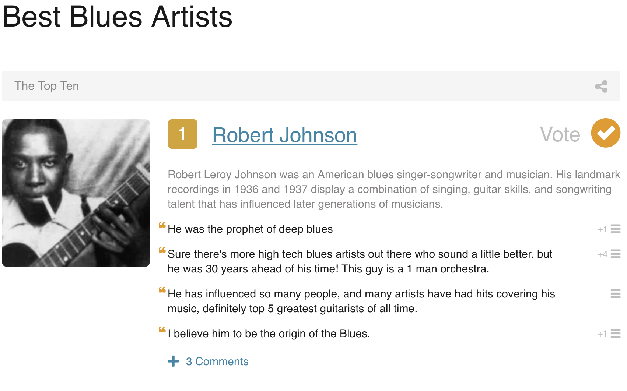
TOP 10 PER GENRE
Most popular artists from all the most popular genres of 1950-2000
Data from thetoptens.com
Notes:
Solved this problem by homing in on artists from older genres and running them through the same modules
Unfortunately, this STILL didn’t sort out the class imbalance

Slide 20
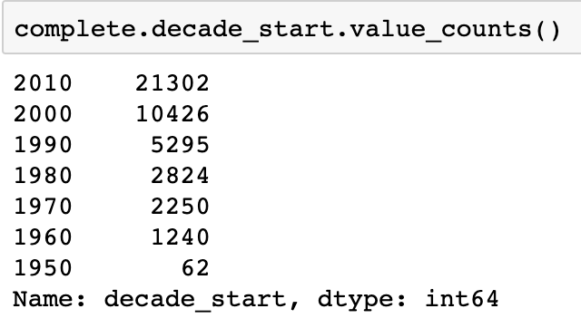
CLASS IMBALANCE
Strong preference for later tracks
Barely any from <1970
Notes:
This problem comes mainly from the way Spotify stores albums, and from the quirks of converting audio into digital formats
Tape recordings were invented in the 50s, CDs in the 70s - if given a choice between that and a low quality vinyl conversion, Spotify will choose the later version and say it’s from that time or keep only the ‘remastered’ version, which has already had some post-production applied to it.
Very difficult to find digital versions of original recordings from the 60s
From the 80s, audio begins to be made digitally from the outset, or at least converted in a consistent manner, so the quality of the data is more reliable

Slide 21
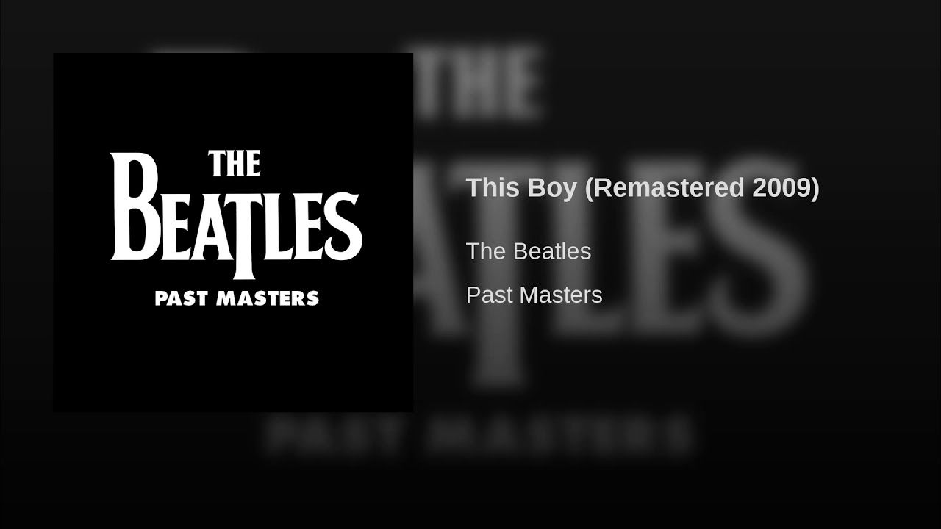
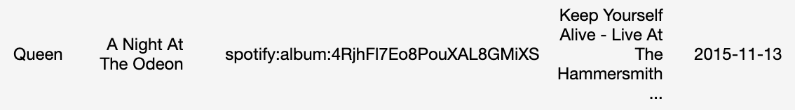
DIFFERENT VERSIONS
Remasters
Compilations
‘Best of…’
Greatest hits
Anniversary editions
Deluxe versions
Notes:
Data nominally had no nulls or duplicates
However, this isn’t the full story
Removed any albums with one of those names in the title (trying to get rid of later stuff)
Sometimes the ‘remaster’ bit is in the name of the track, not the album
Look at the track name - both ‘alive’ and ‘Live’
Solved this by getting the names of everything before a hyphen (which indicates a non-original version) then dropping all but the oldest version of the same song, in the hope that the original one remains

Slide 22
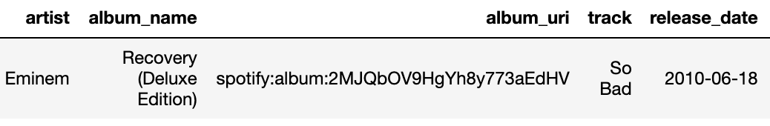
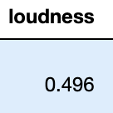
OUTLIERS (WELL, OUTLIER)
Max loudness = 0
Notes:
Having a loudness greater than any speaker can output makes no sense (max 0)
Must be a Spotify processing error
Drop it

Slide 23
25,213 tracks
265 artists
6 decades
Enough to break a laptop, apparently...
Top: Louis Armstrong, 306 tracks
With which to classify
Notes:
I ended up with this

Slide 24
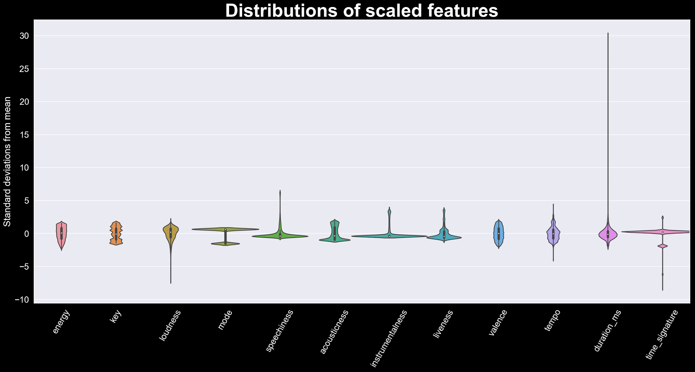
Notes:
Time signature and mode are categorical - TS mostly 4/4 (four to the floor beat), mode mainly 1 = major
Duration has a long upper tail - mostly 3-5mins with some epics (e.g. Bohemian Rhapsody)
Longest songs are mainly interviews, mixes and whole albums - in future will sift through and drop
Loudness capped at 0 and therefore tail has to be below

Slide 25
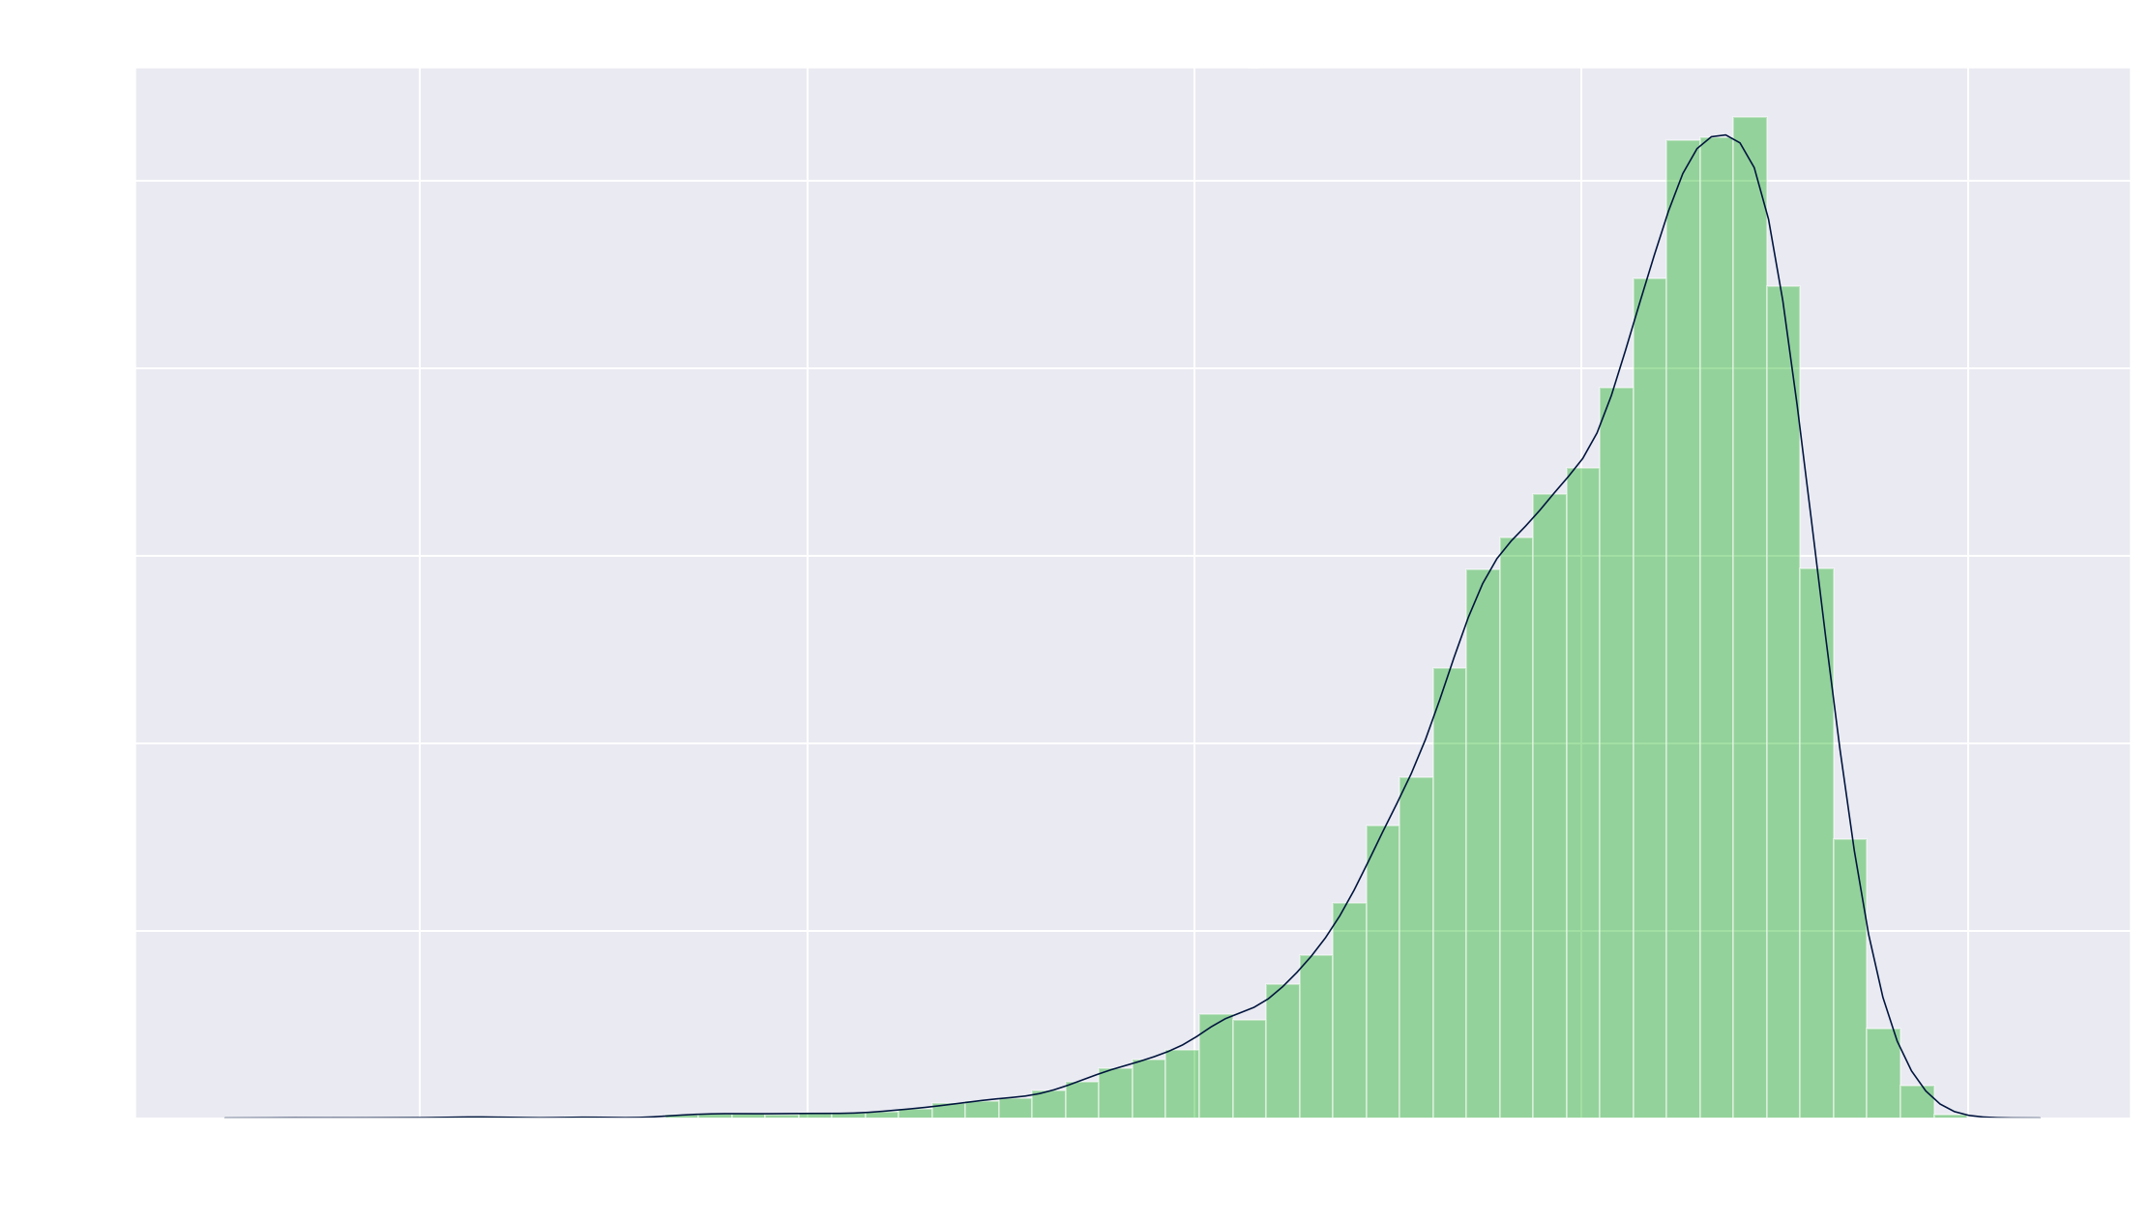
Notes:
There’s the negative skew

Slide 26
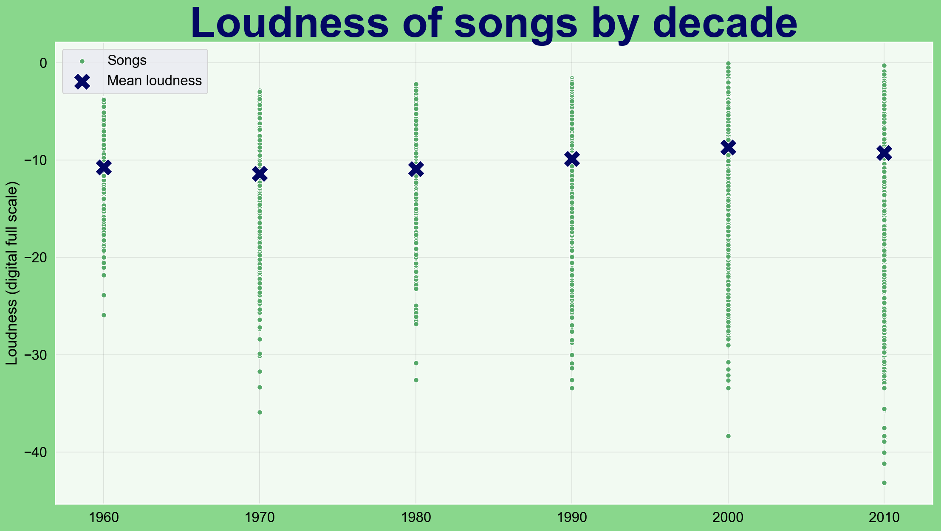
Notes:
Spread increases over time (possibly due to sample size, but more probably due to greater variation with time)
Mean goes up

Slide 27
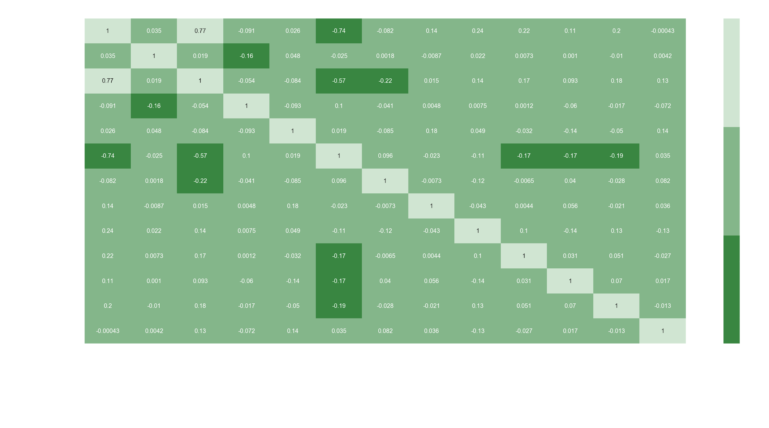
Notes:
N.B. Spotify defines energetic songs as ‘fast, loud and noisy’ - bound to be correlation between that and loudness
Energy vs acousticness
REGULARIZATION

Slide 28
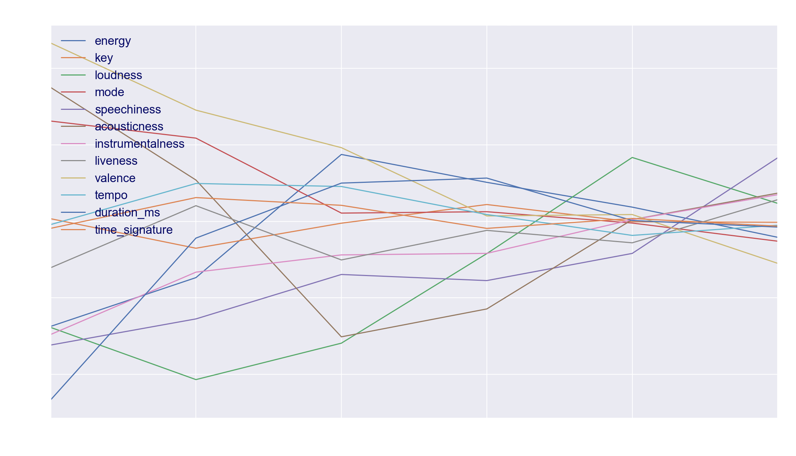
Notes:
Hard to read, but notice:
Loudness (green) going up
Speechiness (purple) going up, maybe due to rap/hip-hop
Valence going down. Millenials are all depressed

Slide 29
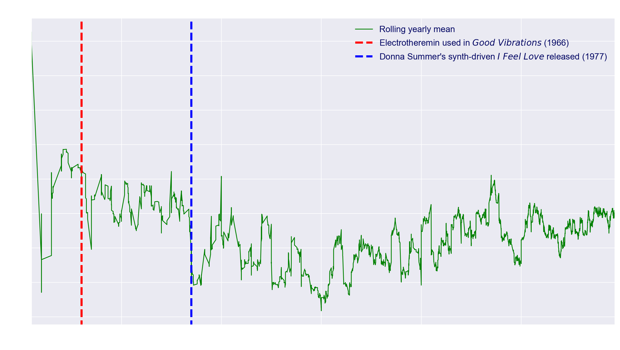
Notes:
Spotify's acousticness feature is a confidence measure of whether a track is acoustic or not.
The conflict between electronic and acoustic music has been around longer than you might think. While the first synthesizer (using electricity as a sound source) was developed as early as the 19th century, it was not until much later that they became popularised. One might recognise the slightly kitsch-sounding theremin from the soundtracks of 50s films such as The Day the Earth Stood Still (1951), and a variant of it, the electrotheremin, was used in The Beach Boys' 1966 hit Good Vibrations.
With the 1977 release of Donna Summer's I Feel Love, produced by Italo Disco pioneer Giorgio Moroder, the synth established itself as a defining feature of contemporary music, and acoustic instruments became a thing of the past.
We can see the mean acousticness falling over this time period, with the events in question marking this decline. Somewhat surprisingly, acousticness bounces back after the 1990s. To explain this, we need only look at the kind of tracks in the dataset post-2000, which are perhaps not fully representative of the dance music-driven tastes of modern pop, as the swathes of EDM DJs currently in action are not well-represented in musical top-10/top-100 lists! In addition, Spotify prioritizes electric guitars as unacoustic instruments, and the least acoustic tracks by Spotify's standards are all electric guitar-based, lending themselves to rock, metal and punk:

Slide 30
3.
Headliner
Modelling & analysis

Slide 31
Steps
Linear regression
Dealing with class imbalance
Classification on decades
Binarizing
Notes:
Don’t expect too much from this, I ended up having to simplify the model quite a bit to get good results
Linear regression using loudness
Binarizing pre- and post-2010

Slide 32
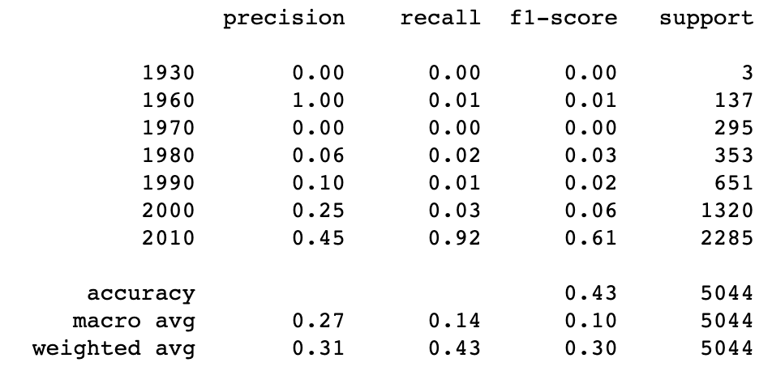
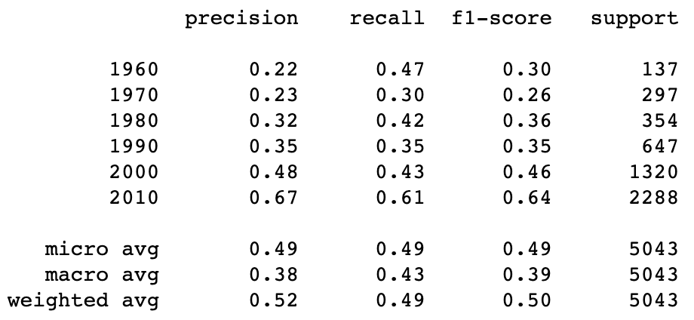
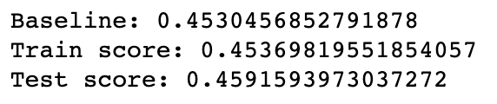
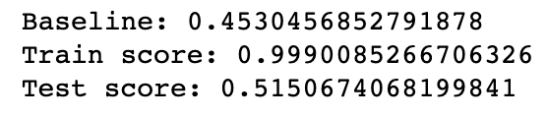
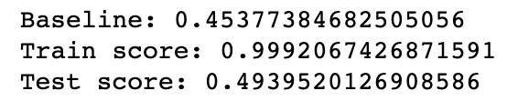
MODEL SCORES
Oversampling with SMOTE-NC
Dealt with overpredicting the better represented classes, but accuracy suffered
Logistic Regression
0.6% above the baseline - not ideal
Bagging LR
Test score improves significantly
Notes:
Multicollinearity present - gridsearched with varying regularization to get the best result
Same again but with bagging (bootstrap aggregating acronym, sampling with replacement). Train score here is the best GS one, so comes mainly from randomly getting the perfect sample. Test score is a good increase, but we’re still over-predicting the majority class (2010).
Synthetic Minority Over-sampling Technique for Nominal and Continuous - Oversampling method that supports a mix of categorical and continuous features. (Random Forest)
Gave a better mix of classes, better precision and recall, but accuracy suffered
N.B. KNN and SVM took too long with this dataset
Tried PCA but explained variance didn’t fall off very fast

Slide 33
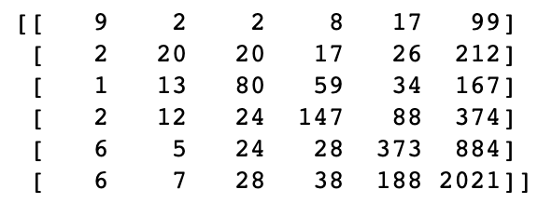
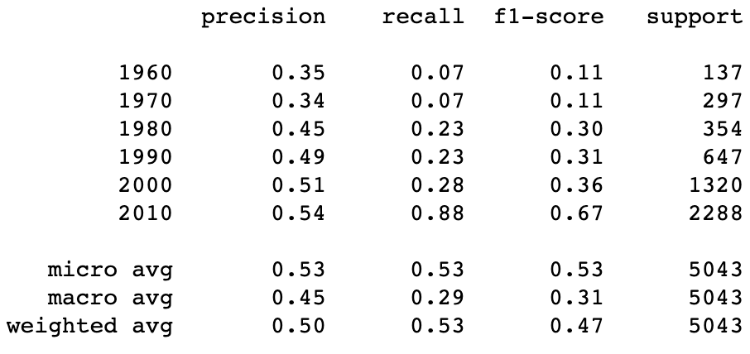
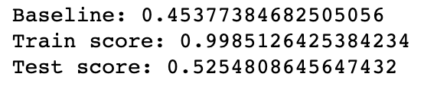
BEST: RANDOM FOREST
No oversampling
Random feature selection takes care of multicollinearity
Combination of random feature selection and bagging optimized for decision trees
Notes:
Random forest gave the best accuracy, but mainly predicts post_2010 data - not a particularly interesting conclusion (hence the low recall, i.e. lots of false negatives, for other classes)

Slide 34
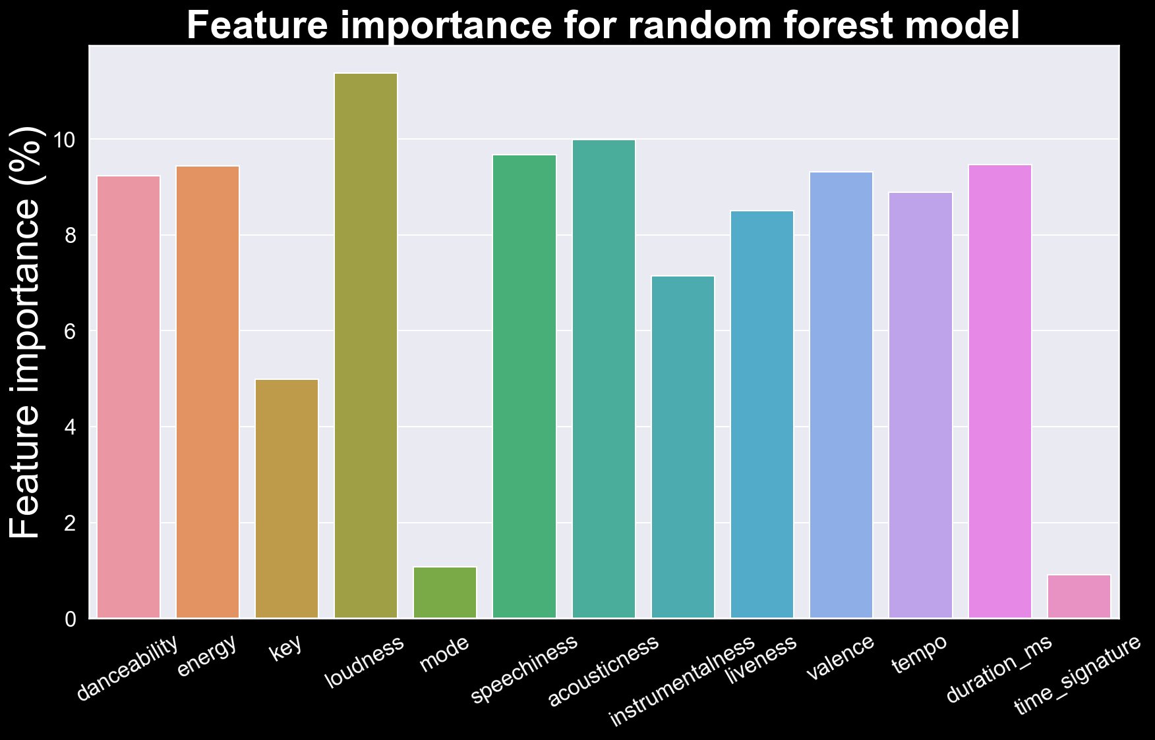
FEATURE IMPORTANCE
Notes:
Loudness is the most important feature - initial hypothesis confirmed! Remember, speechiness shoots up over the last few decades, probably because of rap music, trap music and hip-hop. Acousticness comes down to synths, and electronic guitars

Slide 35
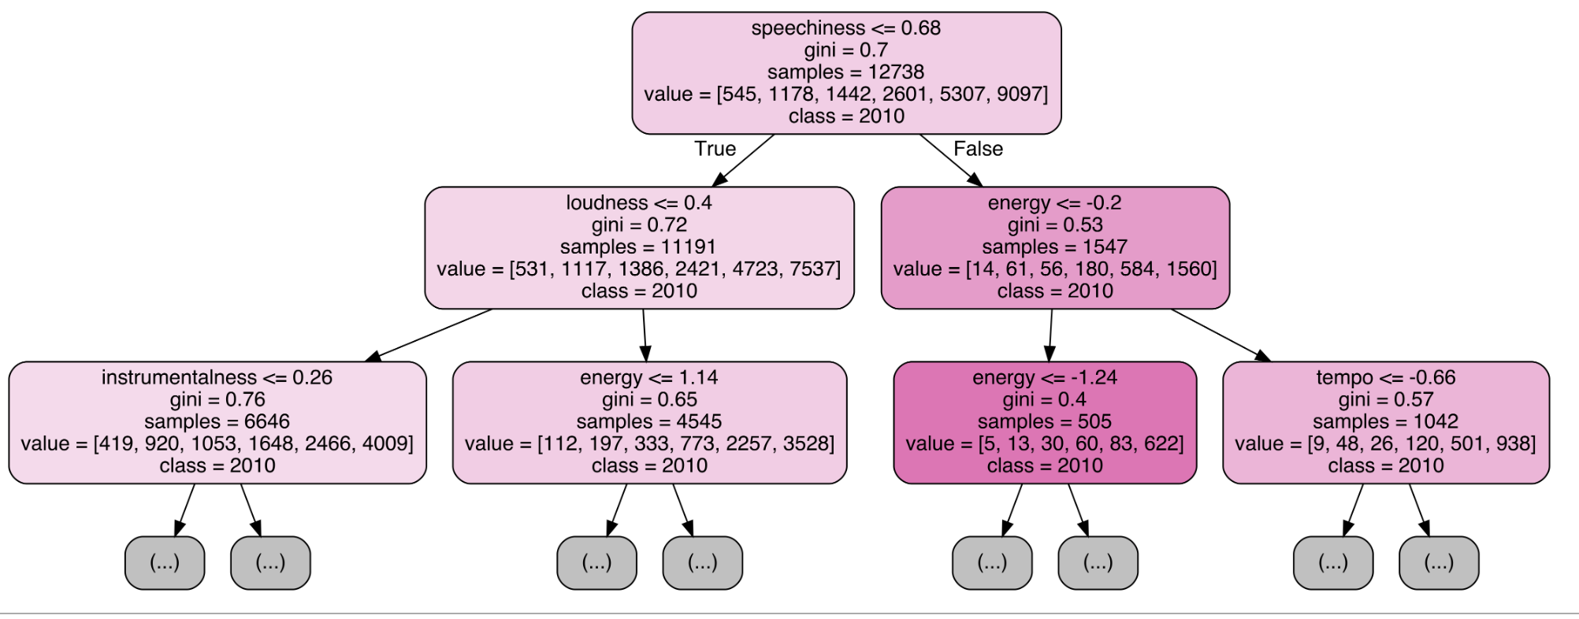
EXAMPLE DECISION TREE CLASSIFIER
Notes:
Note how the correlated loudness and energy are still overrepresented despite bagging (might just happen to be this decision tree). In future, could drop energy and try again.

Slide 36
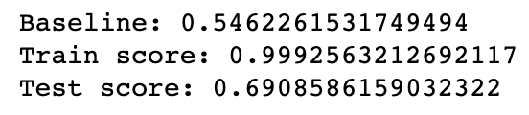
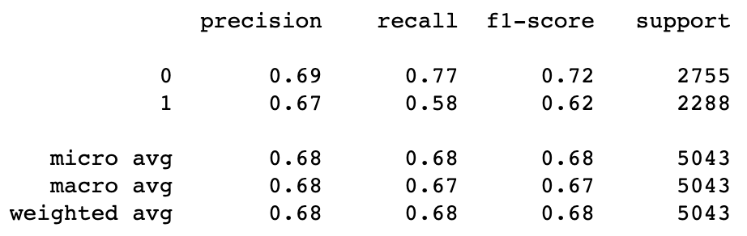
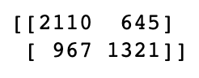
WORKAROUND 1: BINARIZE
Our main problems: class imbalance and too many classes
Why don’t we solve them all in one step?
1 for post-2010, 0 otherwise
Notes:
Creds Tom
Much improved on the baseline - still over-predicts 2010+
Important features - loudness, energy, speechiness, acousticness, valence

Slide 37
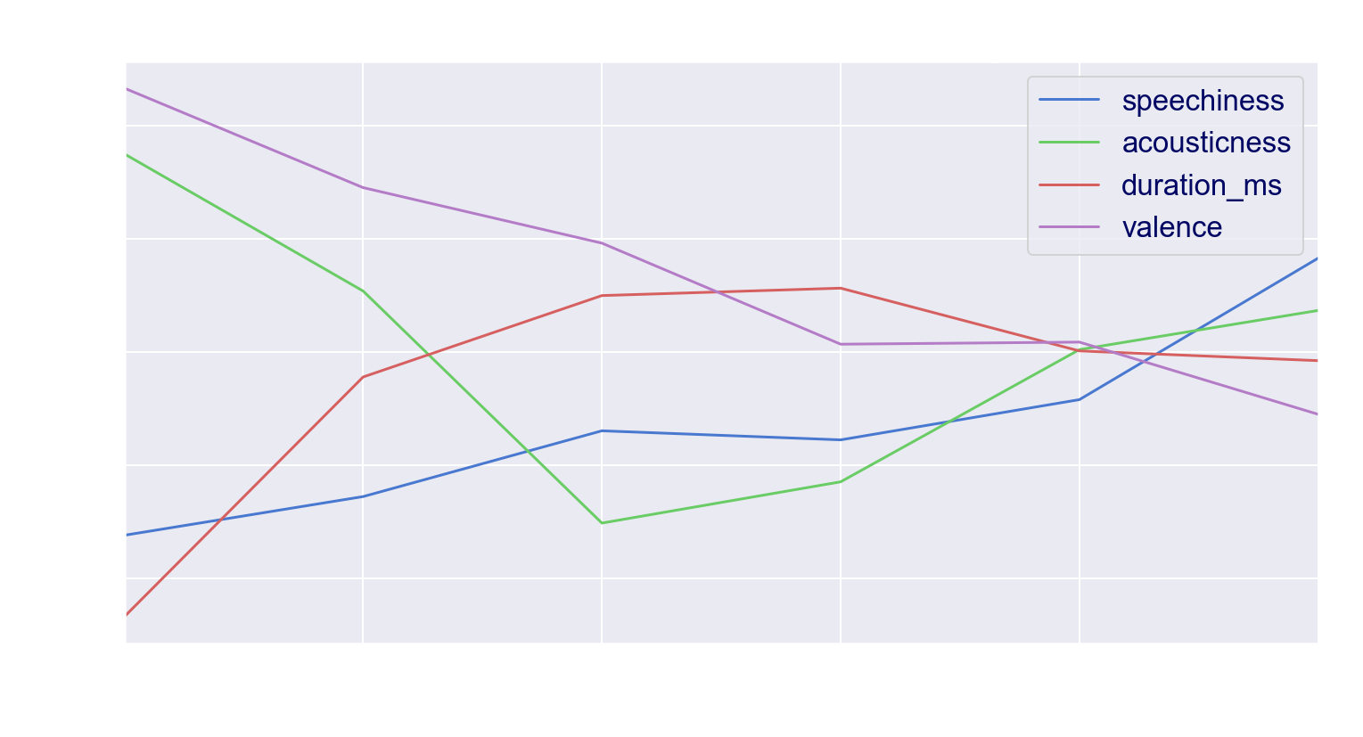
Notes:
Let’s revisit a more easily readable version of an earlier graph - duration aside, in most of the features 2010+ can be clearly differentiated from before

Slide 38
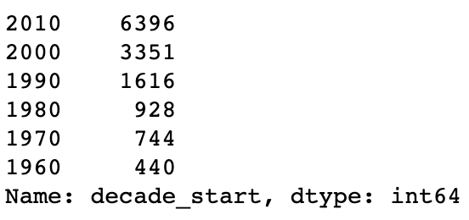
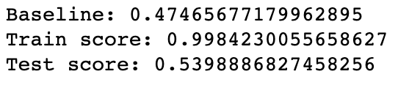
WORKAROUND 2: RESTRICT
Let’s make it easier for the model by using only ***3-7 years
Eras should now be more easily distinguished
Model improves slightly (although other iterations of the earlier RF beat it, implying a level of randomness)
Dataset perhaps now too small
Notes:
Creds Richard

Slide 39

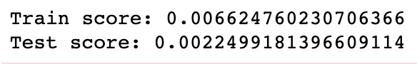
FINALLY: LINEAR REGRESSION
Loudness had the strongest linear correlation to decade
Remember our graph from earlier?
Let’s see how well linear regression from 1984 (release of Pro Tools) onwards fares
Oof.
Notes:
OK, we’ll scrap that

Slide 40
4.
Afterparty
Conclusions & caveats

Slide 41
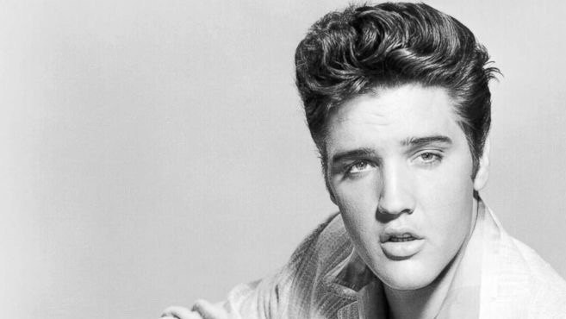
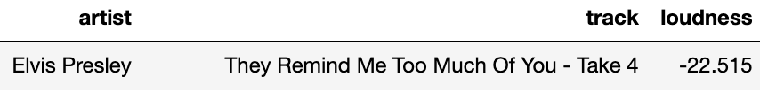
CONCLUSIONS
Predictions
Auditory features can predict the eras of songs, to 52.5% accuracy
Recent times
The last decade can be distinguished from previous ones with 70% accuracy
Loudness
The defining feature in determining how the sound of music has changed over the epochs. As we initially hypothesized, it all comes down to the master!
Modern production
If you’re trying to make it as a producer, you’ll have to master your tracks as loud as you can. Cater to modern tastes!
Elvis, it would seem, is dead
Notes:
Let’s be honest, this was always going to be more of academic interest
Could now advise Spotify on issues with their features, e.g. the acousticness and their dating

Slide 42
CAVEATS
Spotify
To reiterate: features are subjective, dating unreliable
Sampling
Although I have tried to address this, there is still balancing to be done
Live versions
1412 tracks have the word ‘live’ in them
Notes:
I didn’t remove live (laive) because I didn’t want to remove tracks with /lIve/ in them, but long term I’d probably run the model again without them

Slide 43
5.
Upcoming events
Next stages & implementation

Slide 44
Next stages and implementation
‘80s-ness’
Use predicted probabilities to work out how ‘of a decade’ a song sounds
Feature variance by decade
Measure how variant music is over eras
PCA and clustering
See if any decades are more distinct than others
Popularity
Get it from Spotify, use it to model loudness
Sample from decade-themed playlists
Use this as the ‘decade_start’ rather than unreliable Spotify
Avoid bias from sampling albums rather than singles
Predict music based on point of origin
Leave the western hemisphere and see how regions differ
Implementation
Flask app to input a song title
Gets features from Spotify and returns prediction and probabilities

Slide 45
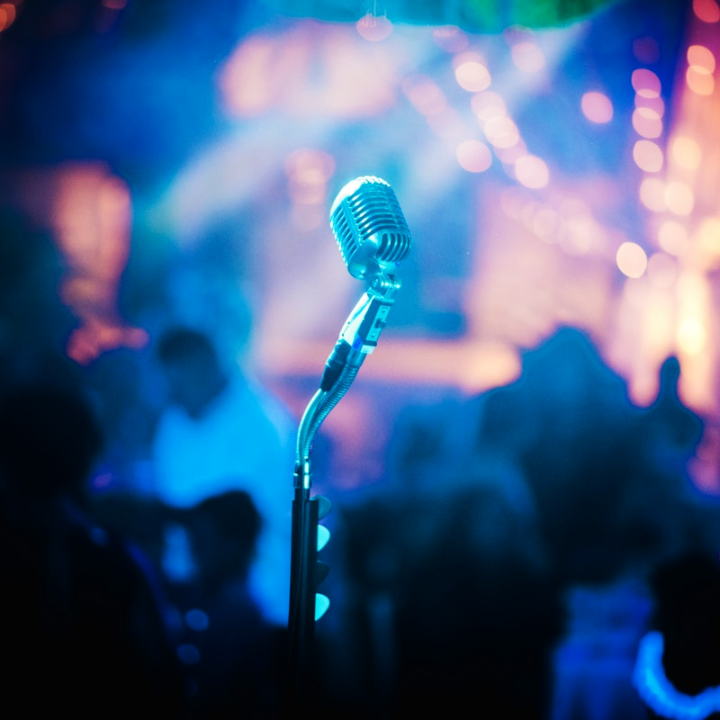
THANKS!
Any questions?
sam_lupton@hotmail.co.uk

Slide 46
CREDITS
Presentation template by SlidesCarnival
Photographs by Unsplash

